Slide 1
DESIGN OF AUGMENTED REALITY AND VIRTUAL REALITY
- ROHAN N KALPAVRUKSHA
ROSHAN N KALPAVRUKSHA

Slide 2

ICE BREAKING ACTIVITY
YOUR NAME AND A WORD THAT WOULD DESCRIBE YOUR PERSONALITY

Slide 3

WHAT IS AR ?
An AR system adds virtual computer generated objects, audio and other sense enhancements to a real-world environment in real time.
A combination of a real scene viewed by a user and a virtual scene generated by a computer that augments the scene with additional information.
SNAPCHAT
INSTA FILTERS
FACE APP
DOGGY FACE

Slide 4


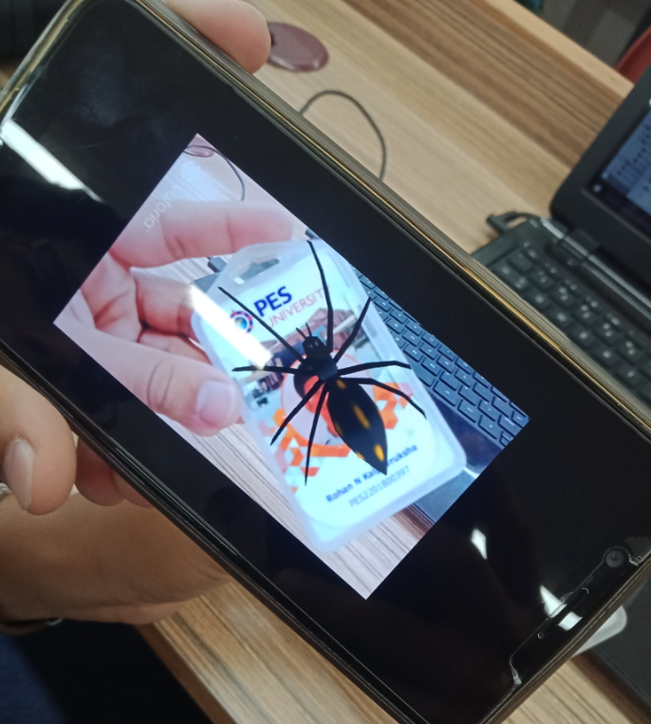
WHAT IS AR ?
REAL WORLD + VIRTUAL OBJECT = AUGMENTED REALITY

Slide 5

WHAT IS vR ?
Virtual Reality means feeling the imaginary(virtual) world, rather than the real one. The imaginary world is a simulation running in a computer.
Virtual reality is the term used for computer generated 3D environments that allow the user to enter and interact with alternate realities.
The definition of ‘virtual’ is near and ‘reality’ is what we experience as human beings.
MIMICS REAL WORLD

Slide 6
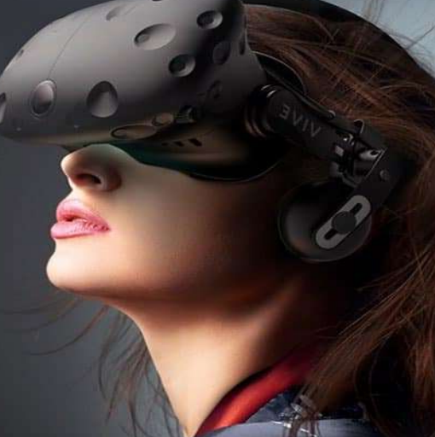
WHAT is vR ?
There are three types of VR
Immersive Virtual Reality
Non-Immersive Virtual Reality
Window on world Virtual Reality

Slide 7
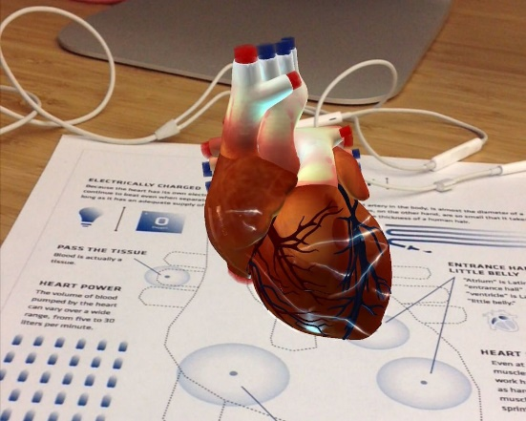
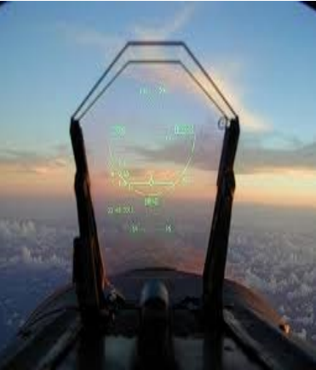
APPLICATIONS OF AR
Medical
Entertainment
Military Training
Engineering Design
Robotics and Telerobotic
Manufacturing and Repair
Consumer Design
Hazard Detection
Audio

Slide 8
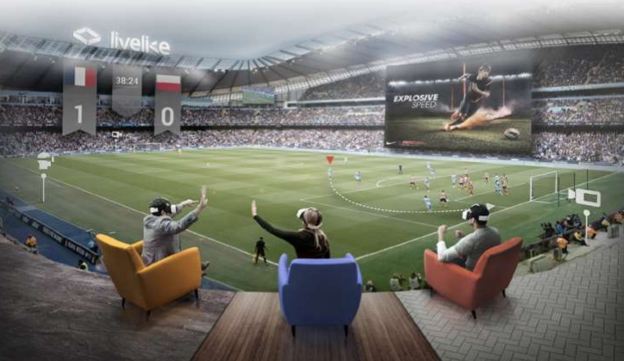
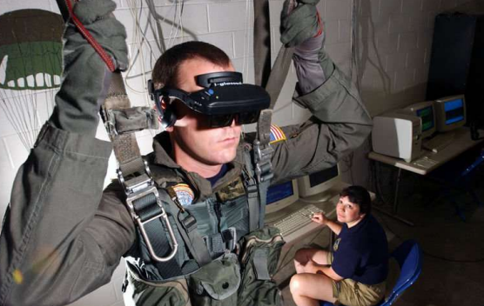
APPLICATIONS OF VR
Medical
Entertainment
Military Training
Scientific visualization
Education

Slide 9
DIFFERENCE BETWEEN AR AND VR
Augmented Reality | Virtual Reality
System augments the real world scene | Totally immersive environment
User maintains a sense of presence in real world | Visual senses are under control of system (sometimes aural and proprioceptive senses too)
AR is 25% virtual and 75% real | VR is 75% virtual and 25% real
This technology partially immerses the user into the action | This technology fully immerses the user into the action
AR requires upwards of 100 Mbps bandwidth | VR requires at least a 50 Mbps connection
No AR headset is needed. | Some VR headset device is needed.

Slide 10
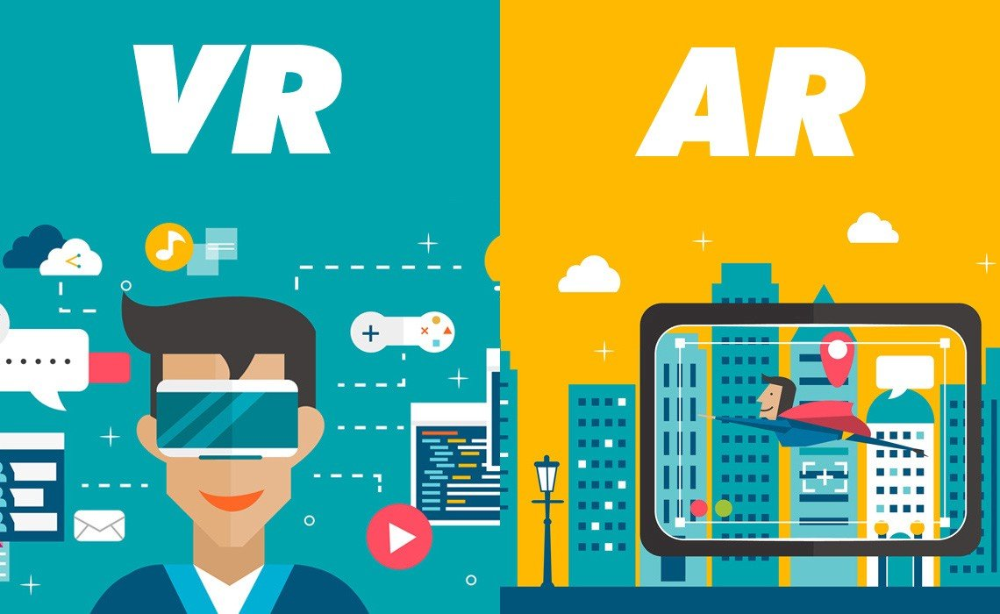
DIFFERENCE BETWEEN AR AND VR

